Slide 1

Selling web services to senior management
Using web services to provide flexibility, competitive advantage and reduced cost
Chris Tham
Head of Architecture, MLC

Slide 2
Overview of presentation
This presentation is a case study of the journey that MLC undertook on the road to defining and implementing a target architecture based on Services Oriented Architecture (SOA) and web services.
It illustrates the difficulty of building and justifying a business case for Enterprise Application Integration (EAI) and why it is important to be able to clearly articulate business benefits and link to real business drivers and requirements.
It also illustrates the need to continuously educate management about the financial benefits and necessity of integration.
It demonstrates that the right approach will result in an architecture that:
  Maximises flexibility
  Provides competitive advantage
  Allows the integration of legacy systems rather than rebuilding
  Optimises IT spend
  Enhances speed to market

Slide 3
A brief history of MLC’s experience with Enterprise Application Integration technologies up till early 2003 and lessons learnt
Time Period | What Happened | Lesson Learnt
Pre-history | Mainly mainframe environment – in-house and heavily customised applications, centralised customer database. Data passed from system to system using dummy customer accounts and transactions CICS transactions were screen-dependent – workflow system had to resort to “screen-scraping” techniques | Single view of customer lost when non-mainframe apps introduced – need an integration strategy! Avoid using applications as a conduit for data/transactions – creates a dependency Separate user interface from business logic
1997-99 | IT Strategy recommended adoption of BEA Tuxedo for enterprise application messaging Tuxedo deployed in new unit pricing system but only used internally within system, interfaces to other applications via batch files | Just choosing a product is not enough without an effective deployment strategy and roadmap and organisational buy in. Deploying EAI technology does not necessarily lead to high benefit realisation
2000-01 | Middleware project was initiated but subsequently cancelled due to funding constraints A major project developed a web front end in J2EE. However, integration to back-end systems achieved using a variety of methods, creating some reliability and scalability issues | Ensure business benefits of middleware are strongly articulated Dependencies across projects need to be carefully planned and managed
2002-03 | An attempt to justify deploying an EAI hub for data transformation of batch interfaces did not succeed – business case was marginal Debate over whether it was better to rationalise to core systems or build “middleware” across existing systems | Given that it is always easier to “add one more interface” than to deploy new technology, the scope and timing of when to introduce middleware is critical! Understanding true business drivers is critical!

Slide 4
MLC’s governance of architecture is based on the Strategic Architecture Forum (SAF)
Decision making body, focus is proactive rather than reactive
Agrees on key strategic architecture and solution design decisions focusing on both "what" (conceptual) as well as "how" (physical/pragmatic/delivery/transition)
Syndication group for enterprise solutions
Ensure all points of view are covered in decision process, not just Architecture
Link a project/component bottom up view with enterprise/strategic top down view
Ongoing input from external views/vendors to develop greater awareness and understanding of new offerings
Outward communication to business and BT on strategic positions including educational aspect
Escalation point for key issues/exemptions from architecture group
Takes a leadership role for ‘technology’ position papers

Slide 5
The “EAI Business Case Development Tool” was used to help quantify the benefit of EAI versus custom integration. The modeling uses the following process flow:
START
TCO MODEL
Examine Business Plan
Resources
Applications
Interfaces
Architecture
Software
Hardware
Training
Project plan
Ongoing operations
Calculate
OUTPUTS
Cash needed to break-even
TCO
Export IT related issues
INPUTS
$0
EAI
No EAI
Scenario
- Scenario Inputs -
EAI Supports positive business benefit?
Number of underlying back-end systems decreases over time
Additional interface requirements from other projects
Ongoing operational costs over a three year period
Stay Custom
NO
FINISH
YES
Go EAI
FINISH

Slide 6
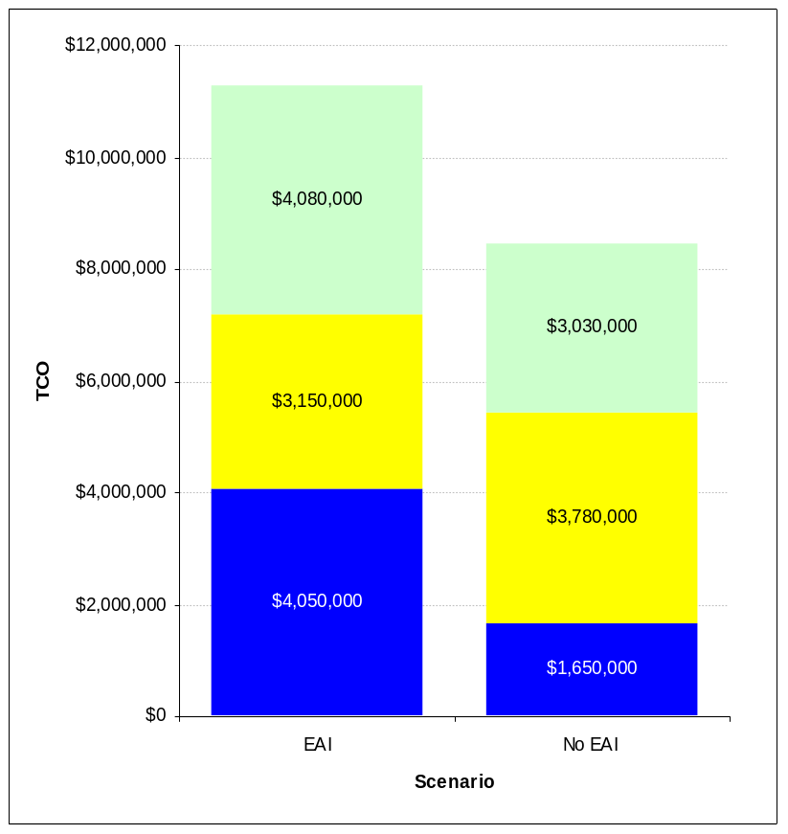
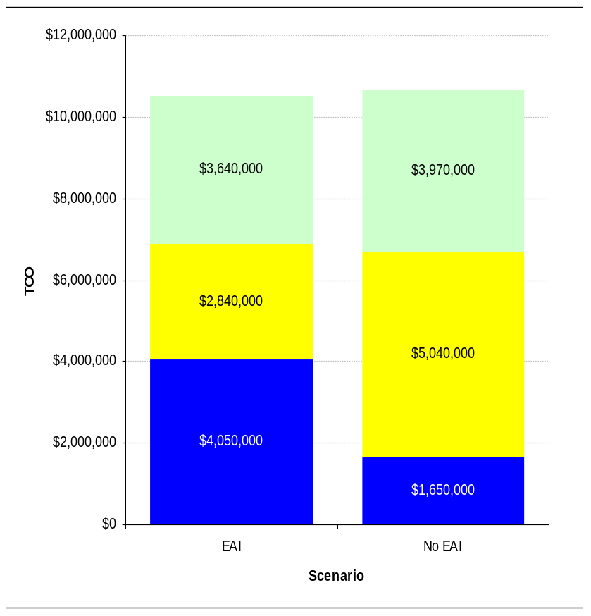
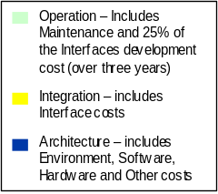
The resultant business case was not compelling, resulting in marginal benefits, and a higher cost than point-to-point interfaces in the worst case scenario.
- Worst Case Scenario -
- Mid-point Scenario -
Assumptions: Based on 126* messages, assuming $25,000 per interface for EAI and $30,000 for interface for No EAI, and a 50% reduction in ongoing interface maintenance costs over a three year period.
Assumptions: Based on 126* messages, assuming $22,500 per interface for EAI and $40,000 for interface for No EAI, and a 65% reduction in ongoing interface maintenance costs over a three year period.
Notes:
* These costs have been provided for comparative purposes only. Its important to remember that the EAI software contains a lot of functionality that will make developing, running,and monitoring the system easier now and in the future such as Business process management facilities, Reusable transformation and formatting components, Auditing, logging, and debugging functions, Pre-built adapters, with upgrades for future releases of software, Message receipt acknowledgement, etc.

Slide 7
EAI, however, does offer significant value over custom integration through benefits that are harder to quantify.
Item | Description
Increased application development capacity | Rapid Development will shorten cycle times for development and free resources to support further integration efforts.
Faster responsiveness to change | Flexible integration allows for changes to the business and technical landscape to occur with minimal rework and impact to production systems.
Increased manageability and maintainability | Manageability and maintainability provide extended technical control of the environment for proactive and reactive management of systems.
Improved access and distribution of information | Improved access to data provided timely and accurate data across a distributed environment while minimising redundancy.
Visibility and control over transaction processing | Business process management promotes the management of integration at the business process level and allows for real-time and historical analysis of business conditions and performance.
Increased interface integrity | Increase interface integrity provides for extended operational control of the enterprise interfaces supporting proactive interface management.

Slide 8
This triggered a strategic discussion on the optimal strategy for MLC’s application portfolio or suite of systems.
Type of System
Strategy
Resulting Target System
Small numbers of customers, accounts & support staff
Off sale products
Front end
Tradeup
Agg & Serv
Record
Keeping
Middleware
Record Keeping
Integrate record keeping system into middleware and use strategic interfaces
Front end
Record
Keeping
Record
Keeping
Agg & Serv
Middleware
Record Keeping
Keep suite but integrate into middleware
Front end
Record
Keeping
Record
Keeping
Agg & Serv
Large Number of customers, accounts & support staff
On sale products
Middleware
Record Keeping
Keep suite and integrate into aggregation and servicing layer (single view of customer, operational data store, consolidated reporting, servicing interface)
Front end
Record
Keeping
Record
Keeping
Agg & Serv
Middleware
Record Keeping

Slide 9
The decision was to defocus on EAI technology and instead develop the necessary software infrastructure to support reusable Enterprise Business Functions (EBF).
- Project -
- Component -
- Scope -
EBF Design Framework
Development of an EBF design framework.
Supporting guidelines for the EBF design framework
The development of the EAI and EBF message standards
MQSeries licenses / maintenance
c.$400k
Middleware Release 1
J2EE Application Development Framework
Assess in-house / group capabilities
Agree scope of components to be built based on EBF Design Framework
Determine project requirements for J2EE components
Design and build of the required J2EE components
c.$300k
Common services Supporting EBF’s
Implementation of selected Common Services that support EBF’s
Design and build of the supporting infrastructure
Supporting operational architecture
c.$800k

Slide 10
What is an EBF?
An EBF provides the functionality to perform specific common business operations, and makes that available to the enterprise.
Local Interface
Local Interface
Enterprise Business
Enterprise Business
Function
EAI Services
Function
External Business
Business Module
Module
Common Application Services
Common Application Services
Internal Business
Business Module
Module
Database Services
EAI Services
Database Services
EBF Framework
Definitions
Guidelines and rules for EBFs
Evaluation of packages as EBFs
Usage Contracts
Patterns for application integration
Integration technology
Common Security Architecture
Benefits
Reuse
Improved time to market
Promote proven, high quality solutions
Reduced functional duplication
Minimise point to point solutions
Increased platform consistency
Known performance and behaviour

Slide 11
Subsequently, MLC then made a number of related decisions, all individually justified and presented to the SAF
Developed an enterprise-wide logical data model that was consistent with industry standards and best practices
Adopted XML as a format for exchanging messages and data across applications
Evaluated and made a decision to adopt Microsoft .NET as a framework for desktop-centric application integration
This created a need to provide inter-operability between desktop application components (in .NET) and back-end enterprise business functions (in J2EE)
Which became an opportunity for considering … Web Services

Slide 12
Web Services Defined (circa 2003)
Consists of three standards
  Simple Object Access Protocol - how to encode an RPC on the wire including exception handling
  Web Services Description Language - how to describe an API. Similar to IDL in CORBA, COM
  Universal Description & Discovery Interface - a public web service repository accessible using web services.
Broad industry support driven primarily by IBM & Microsoft
Uses HTTP as the underlying protocol
Platform and development tool independent
Require no addition hardware or software
Other add-on standards are emerging
  Security
  Transaction
  Coordination

Slide 13
MLC’s justification for adopting Web Services as an application integration mechanism
MLC looked at the application integration architecture used within the National Australia Bank called Global Channel Services or GCS (MQ Series, ROMA, Mercator)
This solution is difficult to justify where
  Application Integration is required to desktop machines
  Application Integration is required to machines outside the corporate firewall
  Solution cost cannot be justified
Current MLC systems are using HTTP based application integration in these situations
Web Services provides a more interoperable standard for these situations
  Standards based - XML, SOAP, WSDL
  Vendor independence
  Platform independence
  Zero client footprint
  HTTP transport layer
  Strong development tool support
  Significant standards activity adding security, transactions

Slide 14
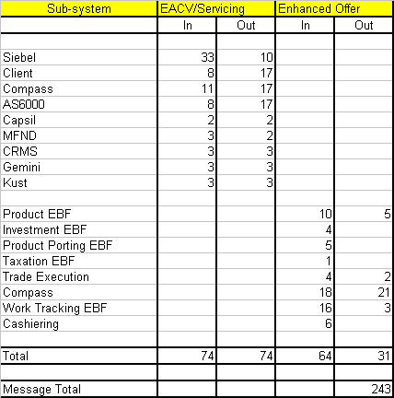
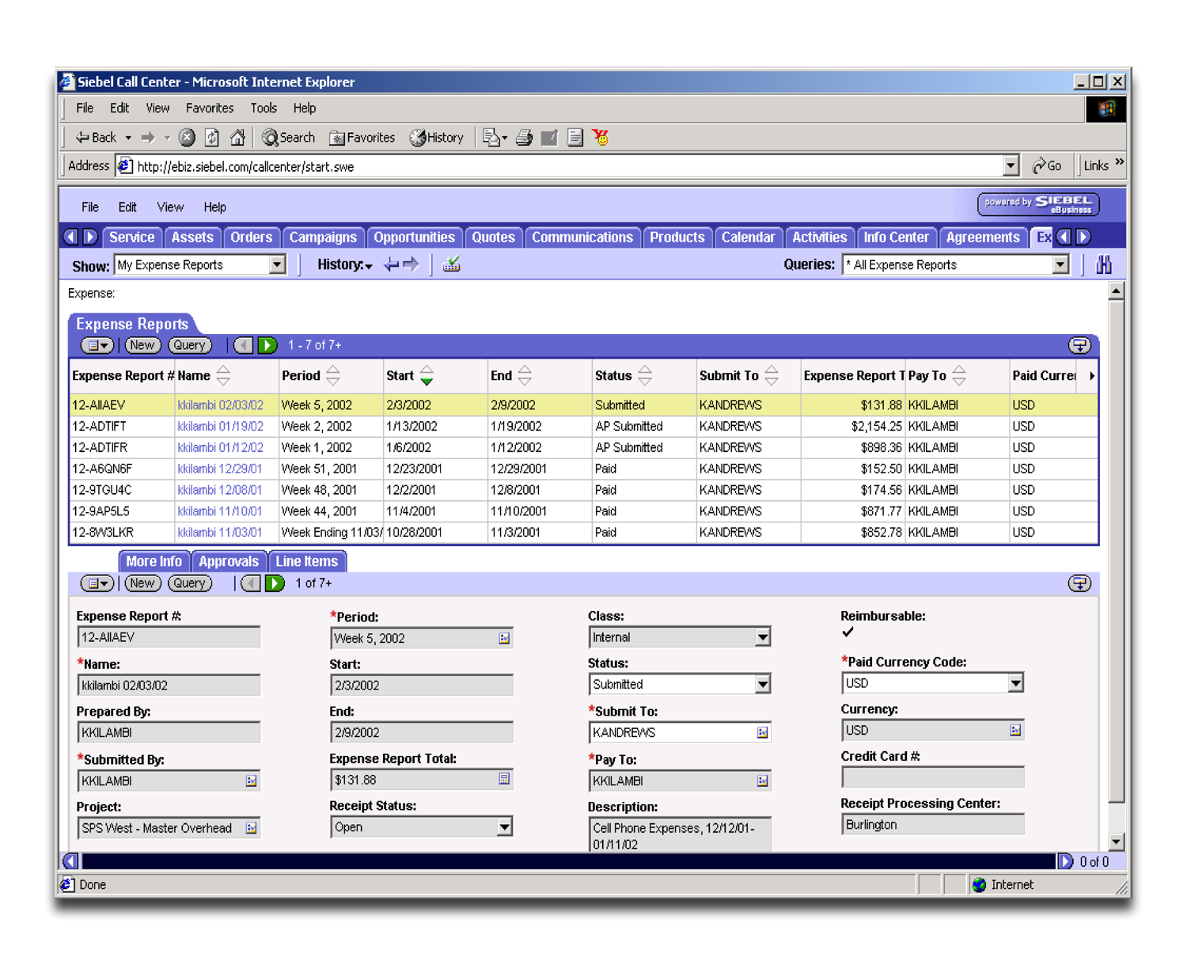
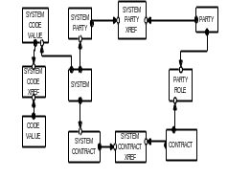
MLC was then subsequently revisited the need to deploy EAI due to additional business requirements.
Architecture Guiding Principles
Reuse -> Buy -> Build
Scaleability
Reusabilty
Vanilla
Performance
Toward Strategic / Best practice
Single View of Customer: Validation of Business Reqts
Establish customer index & core customer data
Provide consolidated enquiry desktop for platform call centre teams
Siebel
Data
Next Steps
Endorse Integration Services approach
Agree to POC / Pilot broker approach to confirm hypothesis
Agree IBM WBI and TIBCO products as POC / Pilot candidates
Broker software
Solution set
Build reusable web service
P2P
What’s Changed
Greater clarity on reqts & hence scope
11 product systems & 240+ messages in release 1
Real time requirement to support servicing
Supports ESM strategy toward a customer centric / servicing model
Impact on Delivery Risk
We have placed + $ in budget for broker s/w
10+ months in project plan (Design to SIT)
Strong view not to build given # of messages & complexity
ESM likely to increase message requirement
1-20
20-60
60+
Messages
Servicing POC has proven P2P
& web services back end access
and connectivity

Slide 15
MLC initiated a successful Proof of Concept, resulting in SAF endorsement to adopt an Integration Services approach based on TIBCO to meet business requirements.
  Objective
  Understand delivery risk (vendor, design patterns)
  Use learnings from pilot to form mitigation strategies (development time, effort and $)
  Confirm our architecture
  Confirm our requirement for Integration Service software for Amazon Foundations and Enhanced Offer streams
  Bring Group architecture and GCS along the journey
  Determine best broker software for MLC whilst ensuring our move toward a strategic architecture
  Determine indicative effort (time and cost) for development effort
  Understand how we would upskill in and use the tool from both a system administrator and a developer point of view
  Validate our hypothesis regards performance / response time of a real time message broker
  Scope
  There are two (2) key integration requirements to be addressed, viz
    1) Real-time (Request / Reply) integration between servicing applications and back-end systems
    2) Near real-time data synchronisation (Data Synch) between systems of record and aggregated data stores
    The pilot will be predicated upon Web Services integration approach and will demonstrate all reference architecture capability (eg. Transformation, orchestration, logging etc)
    The pilot will demonstrate connectivity & integration to our key record keeping systems

Slide 16
MLC’s approach in hindsight turned out to be fortuitous, as it enabled MLC to seamlessly transition into the industry trend towards Service Oriented Architectures (SOA).
A Service Oriented Architecture is an application architecture within which key business functions are implemented as re-useable services with well-defined, invocable, interfaces, which can be called in a defined sequence to form business processes.
MLC’s realisation of SOA is through:
  The EBF Framework
  Enterprise Data Model
  Integration Services and Common Object Model
  Enterprise Security Architecture
Implementation will be achieved by:
  Leveraging key vendor relationships & capabilities
  Exposing key back-end functionality and services / assets

